Slide 1
DAY 5 PPT
LEARN ABOUT ssh , scp, git clone,bash script,shell script

Slide 2
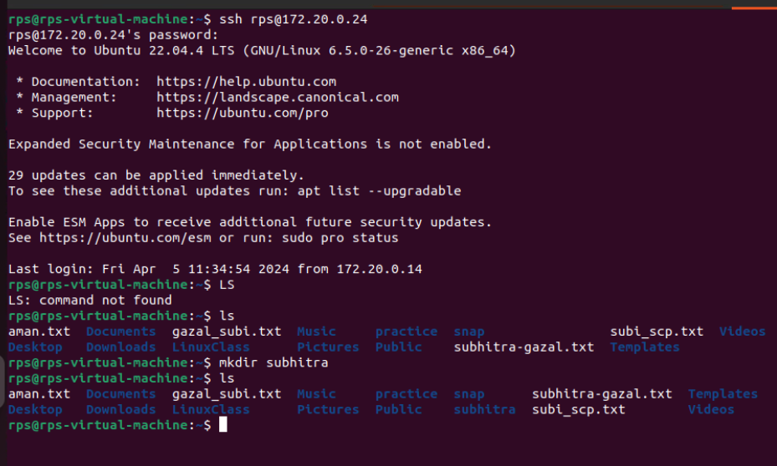
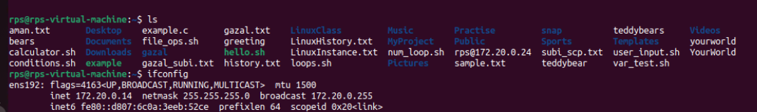
Accessing others inet using ssh
SSH, or Secure Shell, constitutes a cryptographic network protocol designed to enable secure communication between two systems over networks that may not be secure.
This protocol is widely employed for remote access to servers and the secure transmission of files between computers.
In essence, SSH acts as a secure conduit, establishing a confidential channel for communication in scenarios where the network may pose security risks.
This technology is instrumental for professionals seeking a reliable and secure method of managing servers and transferring sensitive data across computers
in a controlled and protected manner.
ssh runs at TCP/IP port 22.
Accessed subhitra’s inet i.e 172.20.0.24
My inet 170.20.014

Slide 3
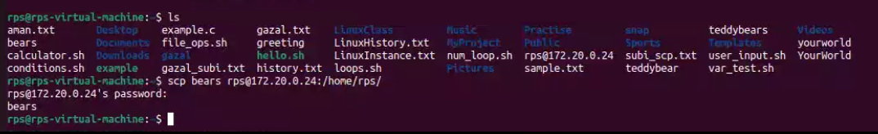
Using scp to move files from my inet to others
SCP is an acronym for Secure Copy Protocol. It is a command line utility that allows the user to securely copy files and directories between two locations usually between unix or linux systems.
The protocol ensures the transmission of files is encrypted to prevent anyone with suspicious intentions from getting sensitive information.
Type exit to log off from helix and get back to your local system
My inet 172.20.0.14

Slide 4
What is git?
Git is a free and open source distributed version control system designed to handle everything from small to very large projects with speed and efficiency.
Git is easy to learn and has a tiny footprint with lightning fast performance. It outclasses SCM tools like Subversion, CVS, Perforce, and ClearCase with features like cheap local branching, convenient staging areas, and multiple workflows.

Slide 5
Why version control
Combine work of multiple collabrators
Understand changes
Support incremental development
Compare and revert to earlier version
Backup
Parrallel versions
Document development(for other developers and yourself ,not for users
Version control is awesome .use it all the time

Slide 6
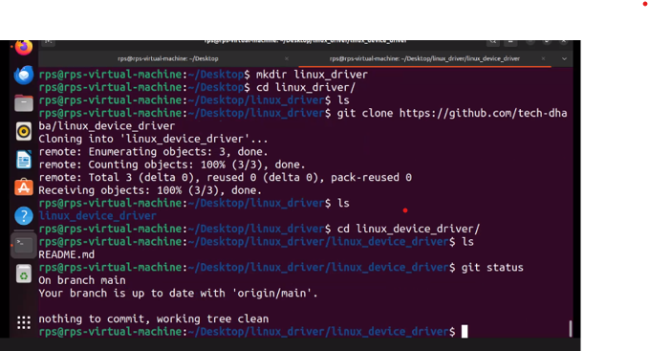
Create a remote repository on gitlab and clone it
Create an account on gitlab and create a public repository called myrepo.then clone it on your local machine by doing

Slide 7
Shell scripting
Here is a super simple bash script called hello.sh:
The shebang is the very first line of the script
#!/usr/bin/env bash
echo “hello world!”

Slide 8
Running first script of bash script
You can also run a script by turning it into an executable program and then running it
First turn the program into executable using chmod
Then run the program
Chmod +x hello.sh
./hello.sh

Slide 9
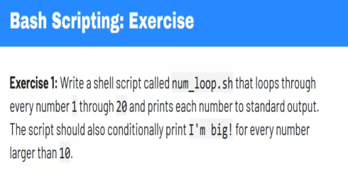
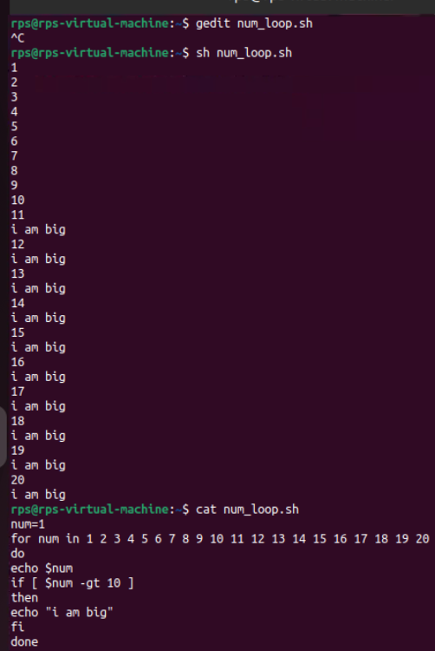
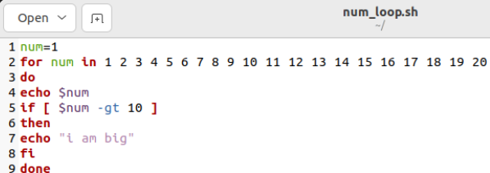
Writing a bash script program
After running command
gedit num_loop.sh

